Slide 1
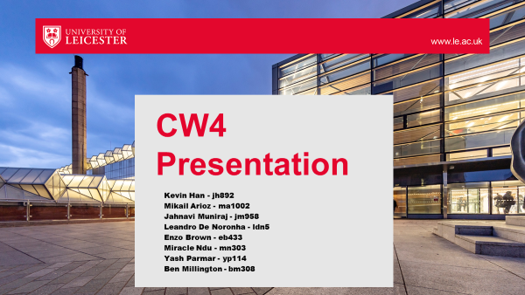

Slide 2
Communication in Our Group
Mikail Arioz - ma1002

Slide 3



How We Communicated
Whatsapp
Outlook
In Campus Meetings

Slide 4
Why We Chose These Platforms? Whatsapp
Features like polls help us allocate work without problems
Being able to reach out to everyone in the group at the same time

Slide 5
Why We Chose These Platforms? Outlook
Ability to share documents
Everyone is familiar as it is been used for educational purposes

Slide 6
Why We Chose These Platforms? In Campus Meetings
Better for group members to help each other
Check any errors in real time without having to worry about waiting for a response

Slide 7
What We Learned
Importance of weekly check-ins
Help us motivate
Importance of helping each other

Slide 8

Overview of the purpose of the project
Miracle Ndu mn303

Slide 9

What did we create
Our project introduces a web application designed to make learning on IBM SkillsBuild more engaging and interactive.

Slide 10
Main objectives
Enhance use of IBM SkillsBuild via our interactive web app
Our aim was to encourage student participation on the SkillsBuild platform
Our goal is to empower students to advance their careers

Slide 11
Key gamification features
User can navigate through interactive learning paths designed to make the learning experience more engaging and enjoyable
This progress can show up on the dynamic leaderboard system allows users to track their progress and compare their achievements with peers.

Slide 12
Key gamification features
Users can visualise their learning journey and track their progress in real-time through interactive dashboards and progress bars.
This visual representation of course completion and achievement milestones motivates users to stay on track

Slide 13
Key gamification features
Avatar Creation
Users can personalise their learning experience by creating custom avatars.
A variety of customization options are available
add a fun and personal touch to their learning journey.
This feature enhances user by allowing individuals to express their personality through their avatars

Slide 14
Benefits
Increased Engagement:
By incorporating gamification elements such as points, avatars and leaderboards
Fun and Enjoyable Learning:
The avatar creation feature allows users to express their creativity.
Interactive progress tracking make the learning journey more enjoyable and rewarding,

Slide 15
Benefits
The social features of the web application
Users can connect with peers and follow their achievements
Career Advancement:
Digital credentials earned through completing courses on IBM SkillsBuild can be shared on platforms like LinkedIn,
users can strengthen their resumes and position themselves for career advancement opportunities
Notes:
, create a sense of community among users . enhancing users' professional profiles and credibility.

Slide 16
Conclusion
Our web application, transforms online learning into an engaging experience.
With gamification elements and social features, we foster collaboration.
our platform can empower users to excel academically and advance their careers.

Slide 17
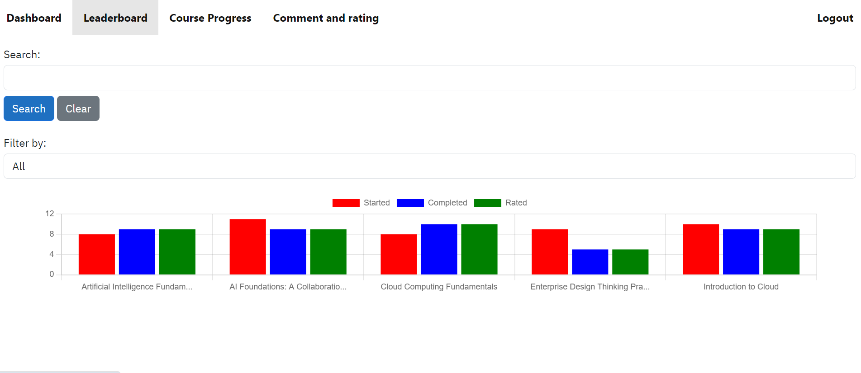
Ethical Issues
Enzo Brown, eb433
Collection of data
Ethical issues surrounding it
How we approached the issue
Further improvements

Slide 18
Why Data Collection is an Ethical Concern
Enzo Brown, eb433
User Surveillance
Reveals a user’s opinions
Users more susceptible to personal advertising
Breach of privacy
Most users unaware of the extent they are monitored
Security of data
Sensitive data needs to be secure

Slide 19
How we confronted it?
Enzo Brown, eb433
Role-Based Authentication
Role-Based Authentication
User and Admin roles
Anonymity of data
Admin
Analytics Page
User
Rest of Website
Further Improvements?
https://
HTTPS
Prevents Session Hijacking

Slide 20
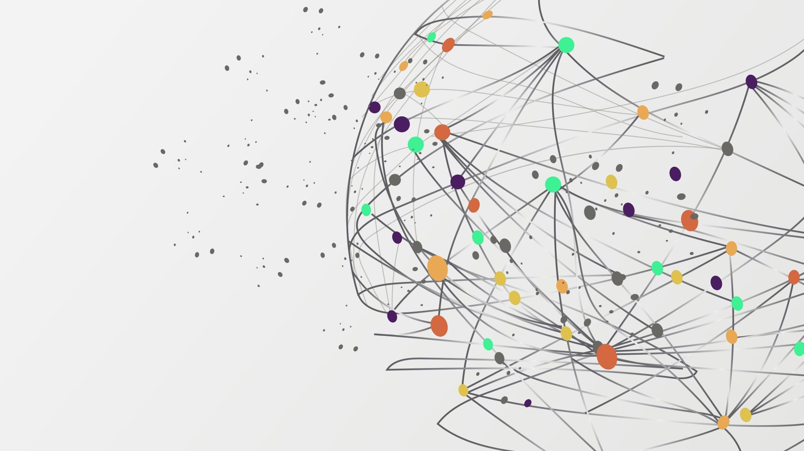
Allocation of work
Kevin Han jh892
Notes:
Allocation of work – how you did this and was it successful?

Slide 21

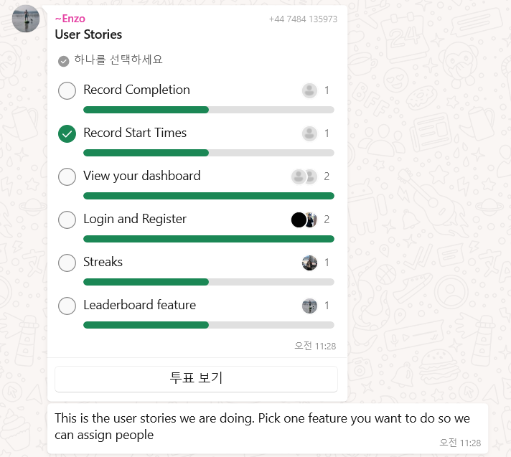
How we allocated the work?1-1
WhatsApp Polls
Freely choosing preferred user story
Available to see the allocation clearly
Can be modified easily

Slide 22
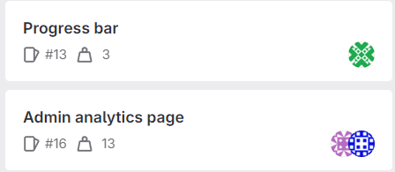
How we allocated the work?1-2
Issue weight
Multiple members manage high weight
Equally separated work amount according to weight
Reduce struggle of individual handling large task

Slide 23


Was it successful?
Yes
Most of the group members successfully completed their user stories.
Most of the user stories were successfully combined together to make a functional IBM website.
There were no significant problems throughout the project.
Completed the project on time.

Slide 24
EXPLANATION OF A TECHNICALLY CHALLENGING FEATURE
YASH PARMAR

Slide 25
SOME FEATURES WE IMPLEMENTED
Login and Signup
Leaderboard
Profile
Add Friends system
Course Progression system

Slide 26
REASONS FOR THIS:
Authentication and Authorisation Mechanisms: Authentication verifies users' identities, typically through login credentials like usernames and passwords, to prevent unauthorised access. Authorisation ensures authenticated users have appropriate permissions to access specific pages or perform tasks within the application.
User Registration: User registration involves validating data, ensuring uniqueness, and securely storing data. Validating user-provided data, such as usernames and passwords, prevents vulnerabilities like data breaches and maintains data integrity.

Slide 27
REASONS FOR THIS:
Integration with Frontend: Frontend and backend systems work together to integrate features with frontend elements like registration pages and login pages. This ensures seamless handling of user data validation and implementing secure encryption of user login details such as their password.
Data Modelling and Schema Design: Designing an efficient database schema to represent the systems models is crucial. Determining the relationships between entities require an understanding in database design principles.
Password Encryption: As you are dealing with sensitive data such as user passwords, a strong cryptographic algorithm is needed to encrypt passwords before it gets stored in the database. Therefore, configuration of encryption is crucial to protect the website/users from attacks.

Slide 28


Slide 29
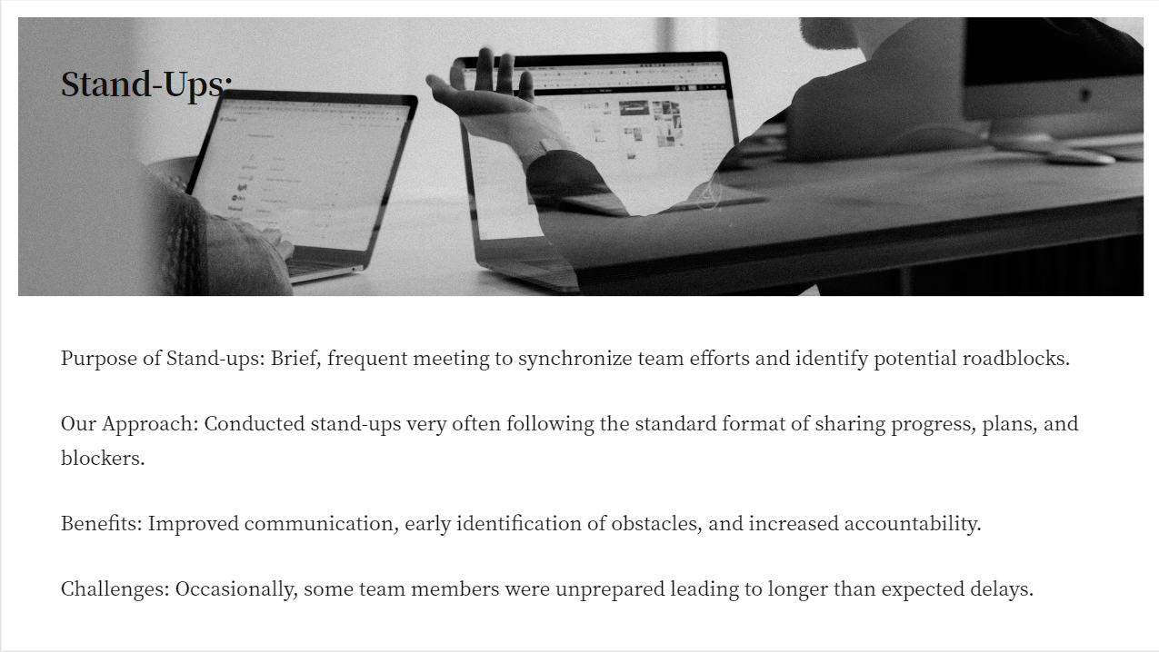

Slide 30
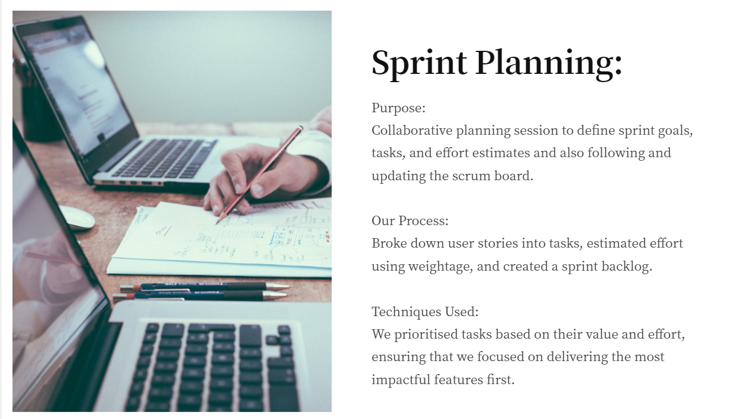

Slide 31
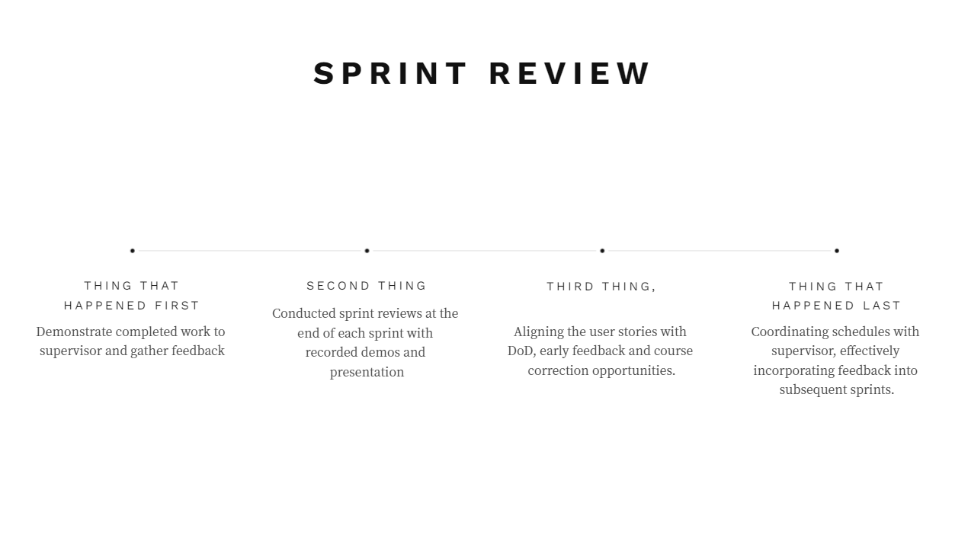

Slide 32
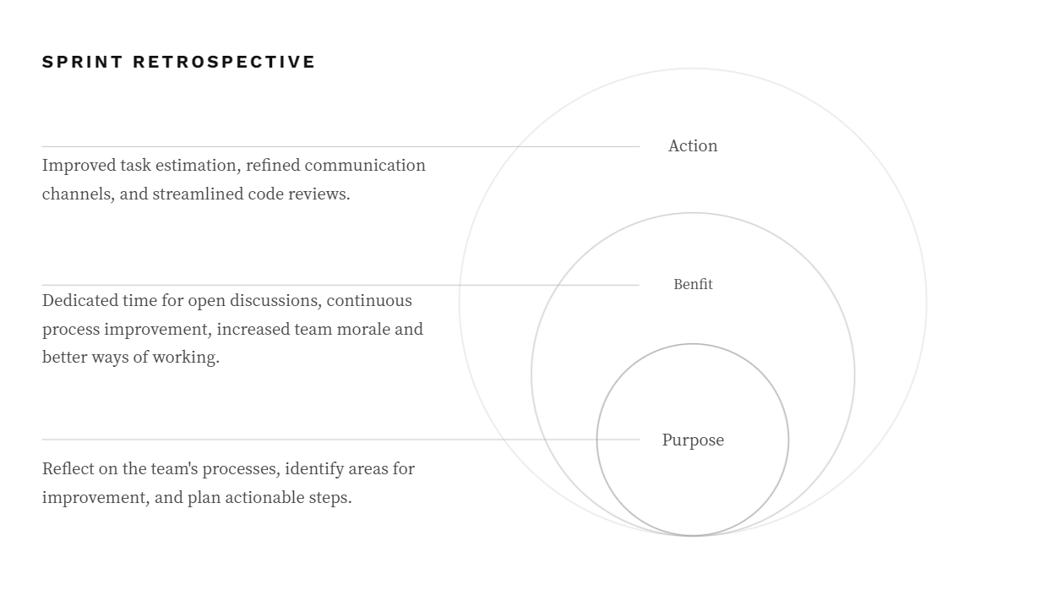

Slide 33
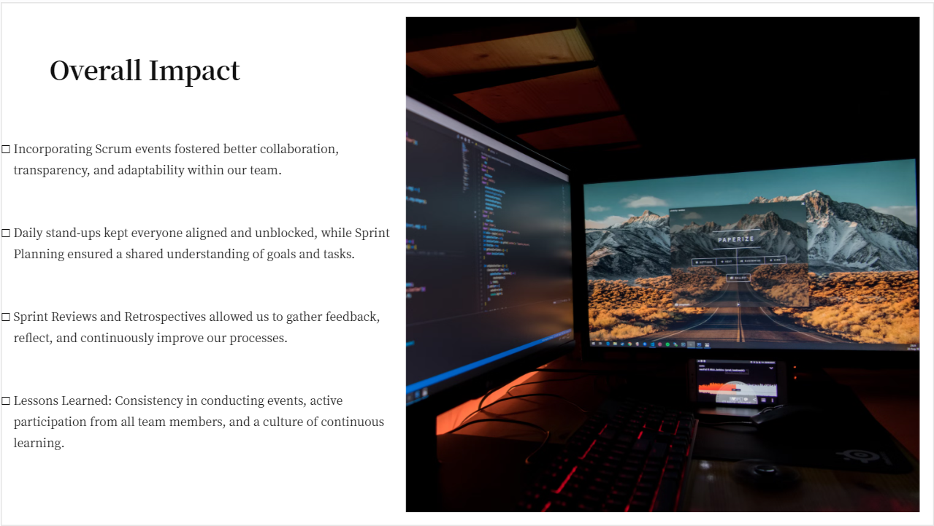

Slide 34

taking this project onwards
Ben Millington – bm308@student.le.ac.uk

Slide 35


Integration with ibm skillsbuild
API Integration
Collaboration with IBM SkillsBuild to use their API or develop our own API.
If API integration is not possible, can the authenticity of simulated interactions be enhanced?
Develop a secure authentication mechanism
Integration Workflow
Users would log in to our app using their SkillsBuild credentials.
Data retrieval and display
Integration must be scalable
Ensure secure communication

Slide 36


features
Enhance Existing Features
Improve UI/UX design
Enhance gamification elements
Perform more rigorous testing
Implement New Features
Notification system
Recommendation engine
Mobile application

Slide 37

Implementation strategy
Team structure and resources
Assign different roles and responsibilities within the group?
Assess the need for additional team members or skill sets
Project management approach
Continue to use scrum?
Set up regular sprint cycles
Establish better communication channels
Technical considerations
Evaluate the scalability and performance requirements
CI/CD

Slide 38

Thank You
bm308@student.le.ac.uk

Slide 39



Collaboration and Adaptability in Software Development
Leandro De Noronha – LDN5

Slide 40
Effective collaboration
. Overcome technical challenges effectively
. Support system for members encountering obstacles
. Clear direction for development on project.
. Sharing advice and skills towards group members
Notes:
Effective collaboration allows for any issues in development to be ironed out. E.g. Bringing in different group members. Can also learn from other members. Brainstorm solutions, see different perspectives on ways to figure out solutions to a quick resolution perhaps.
Support system allows for no failure points within the group, members can support others quickly if others need support, continuing pace. Reduces stress and members to feel comfortable
Clear direction, via effective communication, allows for sprint planning, group members focus on their tasks and know the overall goal.
Members can learn, give their expertise and skills. Strengthens links and knowledge of development. Such as a backend developer assisting frontend development. Improves quality and efficiency.

Slide 41
Challenges & adaption
. Integration issues potentially faced
. Time constraints & heavy workload on project
. Rushed code & complexity in development
Notes:
Collaboration can lead to different solutions if not communicated effectively. This can lead to inefficient code, problems in development and further issues in the development cycle. Can lead to delays in project deadline.
Adaptation. Using regular tests, and group meet ups and mean smooth integration, and troubleshoot any issues to prevent further delays.
2. Lack of communication leads to piling work, last minute work. Leading to extensions, insufficient work and code. Therefore collaboration ensures catching issues early.
Adaptation, Sprint planning, tasks being focused on each members strength and weaknesses, reducing time wasting. More interventions.
3. Rushed code causes problems of further bugs and makes development more messy and complicated. Collaboration can assist and look out for any potential issues.
Adaptation. Scrum master for assistance, more MS team sessions. Getting more experienced group members to handle less experienced ones, reducing the strain in further potential issues.

Slide 42
Key TAKEAWAYS …
. Establishing strengths & weaknesses
. Time planning and strategy
. Sprint checks in place
. Use of Scrum master
Notes:
Allows for strengths and weaknesses to be understood. Makes assigning roles better, allowing for more efficiency.
Prevents tight deadlines, reduces stress in group and work load. Stops potential future issues. Makes for direction in work, and heavy strain on members = balance.
Sprint checks lets us see what is working and what is not working in development, allowing for improvements in project. Detects any issues that may arise in the group. Makes sure group members know what they are doing.
Scum master can resolve conflicts, make sure no disputes can occur. Ensures development continues smoothly, and ensures agile methodologies are used.
Stops issues from becoming significant, reduces delays. Helps project keep on track. Better decision making and best solutions for development.

